Slide 1
Introduction to VLSI

Slide 2
What is VLSI?
Very-large-scale integration (VLSI) is the process of creating an integrated circuit (IC) by combining thousands of transistors into a single chip.
A transistor is a semiconductor device used to amplify or switch electronic signals and electrical power. It is composed of semiconductor material usually with at least three terminals for connection to an external circuit.
The process of Integrated Circuits (IC) started its era of VLSI in 1970’s when thousands of transistors were integrated into one single chip.
Nowadays we are able to integrate more than a billion transistors on a single chip.

Slide 3
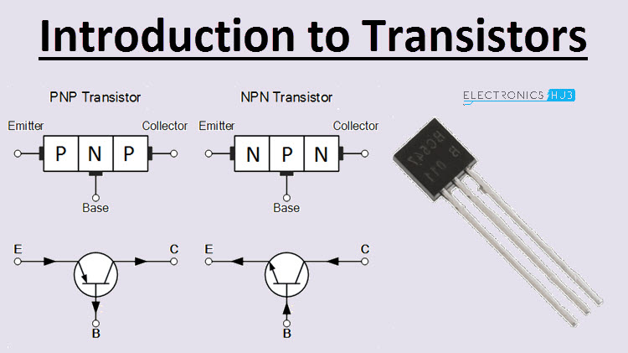
Transistor

Slide 4
What is VLSI?
An electronic circuit might consist of a CPU, ROM, RAM and other glue logic. VLSI lets IC designers add all of these into one.
Now multiple cores are available on a single chip and advantage of that the computer can perform several function parallelly and can process the several threads of a single function parallelly.

Slide 5
VLSI (Continue…)
However, the term “VLSI” is still being used, though there was some effort to coin a new term ULSI (Ultra-Large Scale Integration) for fine distinctions many years ago.
The microprocessor is a VLSI device.
VLSI circuits are used everywhere, real applications include
microprocessors in a personal computer or workstation,
chips in a graphic card,
digital camera or camcorder,
chips in a cell phone or a portable computing device,
and embedded processors in an automobile

Slide 6
VLSI (Continue…)
Multiplexers, Encoders, flip-flops. Many such functionalities are combined in ASICs(Application Specific Integrated Circuits).
VLSI can be implemented using a language called VLSI HDL(Hardware Description Language) which describes the layout, design and Microchips are becoming smaller and smaller.

Slide 7
Integrated Circuits
Integrated circuit or IC or microchip or chip is a microscopic electronic circuit array formed by the fabrication of various electrical and electronic components (resistors, capacitors, transistors, and so on) on a semiconductor material (silicon) wafer, which can perform operations similar to the large discrete electronic circuits made of discrete electronic components.

Slide 8
Classification of IC according to size of integration
Small scale integration (SSI) circuits such as the 7404 inverter have fewer than 10 gates with a conversion of roughly half a dozen transistors per gate
Medium scale integration (MSI) circuit such as 74161 counter have up to 1000 gates.
Large scale integration (LSI) circuit such as simple 8-bit microprocessors have up to 10000 gates.
VLSI such as 512 Mbits dynamic RAM contains more than half a billion transistors.

Slide 9
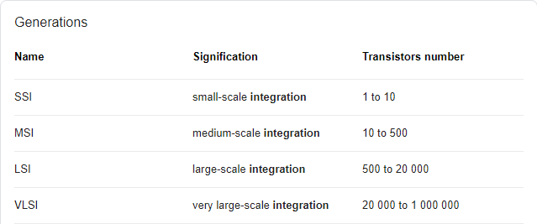
Classification of IC according to size of integration

Slide 10
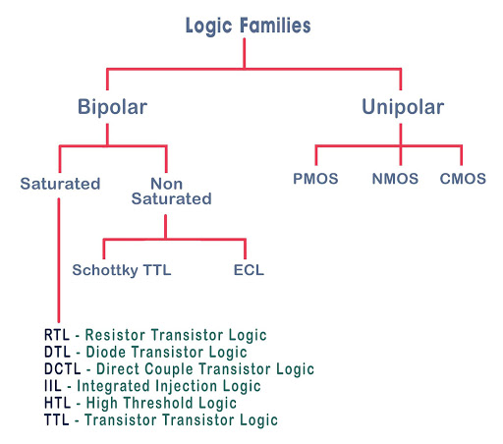
Logics Family
Transistor Transistor logic
Emitter coupled logic

Slide 11
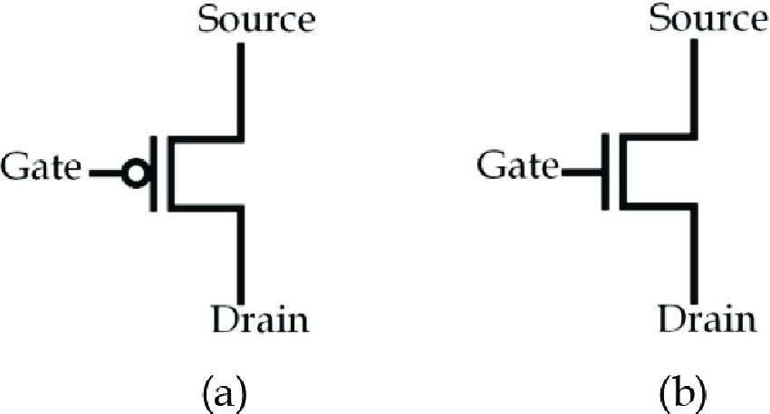
Unipolar Logic

Slide 12
PMOS and NMOS Logics

Slide 13
PMOS and NMOS Logics
Voltage | PMOS | NMOS
0V (0) | ON | OFF
5V (1) | OFF | ON
PMOS (A) | Output (Y)
0 | 1
1 | 0
NMOS (A) | Output (Y)
0 | 0
1 | 1

Slide 14
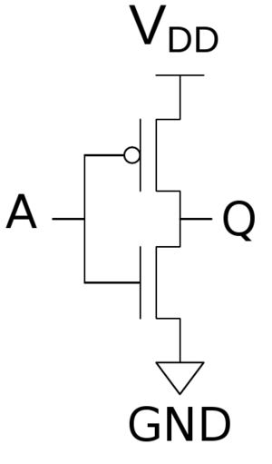
CMOS Inverter
Complementary metal–oxide–semiconductor (CMOS), also known as complementary-symmetry metal–oxide–semiconductor, is a type of metal–oxide–semiconductor field-effect transistor fabrication process that uses complementary and symmetrical pairs of p-type and n-type MOSFETs for logic functions.
A (Input) | Q1 | Q2 | Q (Output)
0 | ON | OFF | 1
1 | OFF | ON | 0

Slide 15
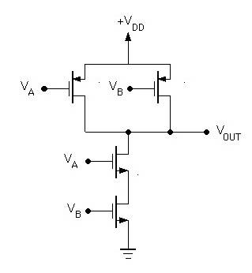
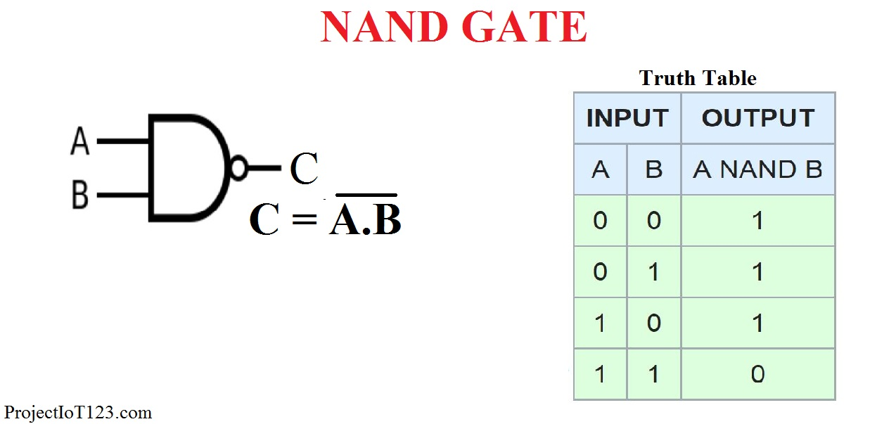
CMOS NAND gate
Va | Vb | Q1 | Q2 | Q3 | Q4 | Vout
0 | 0 | ON | ON | OFF | OFF | 1
0 | 1 | ON | OFF | OFF | ON | 1
1 | 0 | OFF | ON | ON | OFF | 1
1 | 1 | OFF | OFF | ON | ON | 0

Slide 16
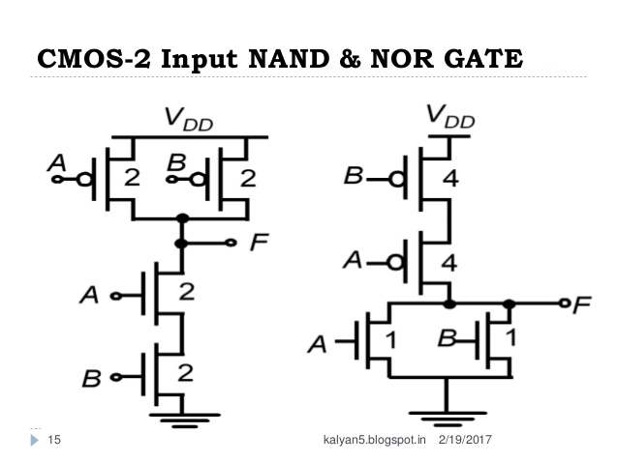
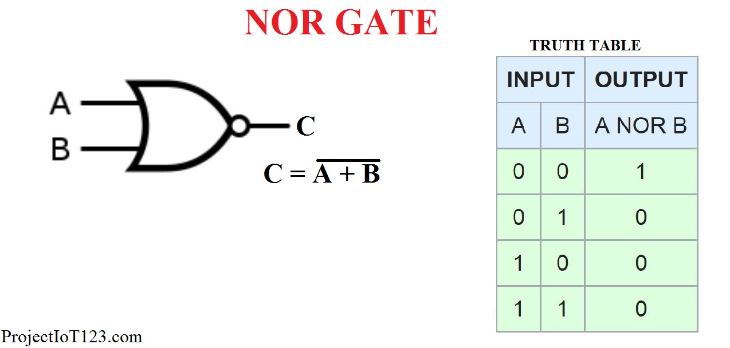
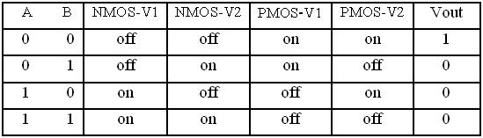
CMOS NOR gate?

Slide 17
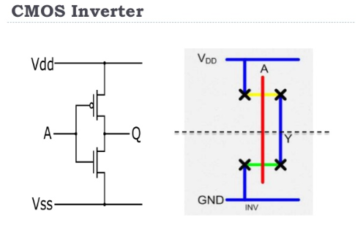
Stick Diagram
Stick diagrams are a means of capturing topography and layer information using simple diagrams.
Stick diagrams convey layer information through color codes (or monochrome encoding).

